Slide 1

Chameleon Converter
Wilson Lopez
Jorge Flores
Dennis Montaño

Slide 2
Introduction
The chameleon converter is a software that search, player, convert files whit extensions: video and audio.
Formats available: avi, mpg, mp4, flv, wmv, mkv, mov
The Chameleon Converter can seach and player this formats.
The chameleon converter work whit software ffmpeg for convert files multimedia.
The chameleon convert save the history convert files.

Slide 3
About Chameleon Converter
Libraries
Jna-352.jar
Plaltform-3.5.2.jar
modelmapper-0.7.7.jar
gson-2.8.0.jar
guava-20.0.jar
ffmpeg-0.6.2.jar
Libvlc.dll
Libvlccore.dll
Npvlc.dll
Vlcj-3.0.1.jar
Plugins vlc Player (dll's)
commons-lang3-3.5.jar
Commons-io-2.5.jar
Sofwtare external
Ffprobe.exe
Ffmpeg.exe

Slide 4
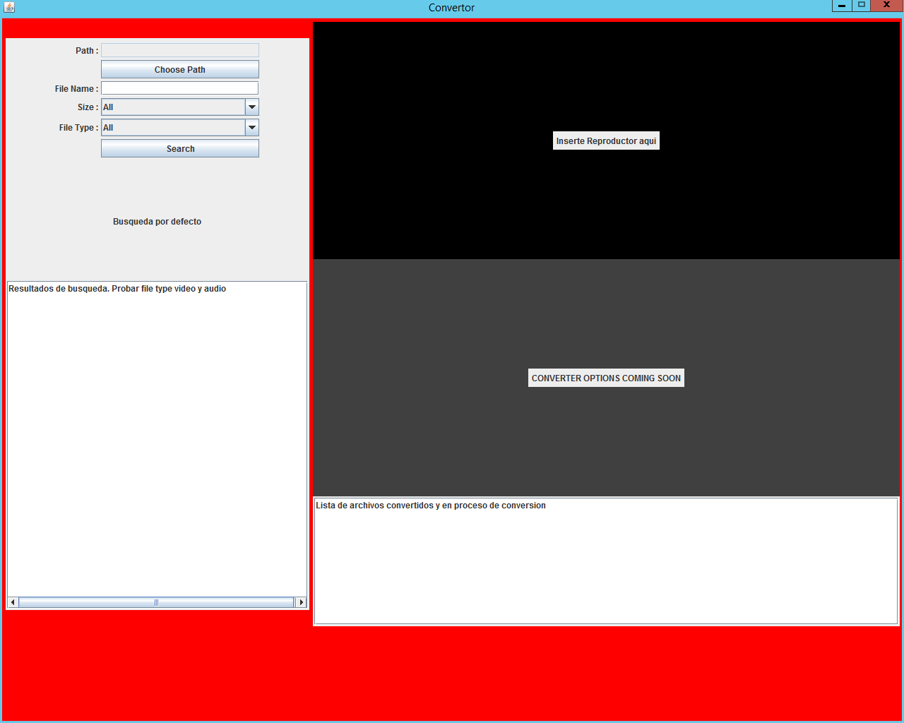
More about Chameleon Converter

Slide 5
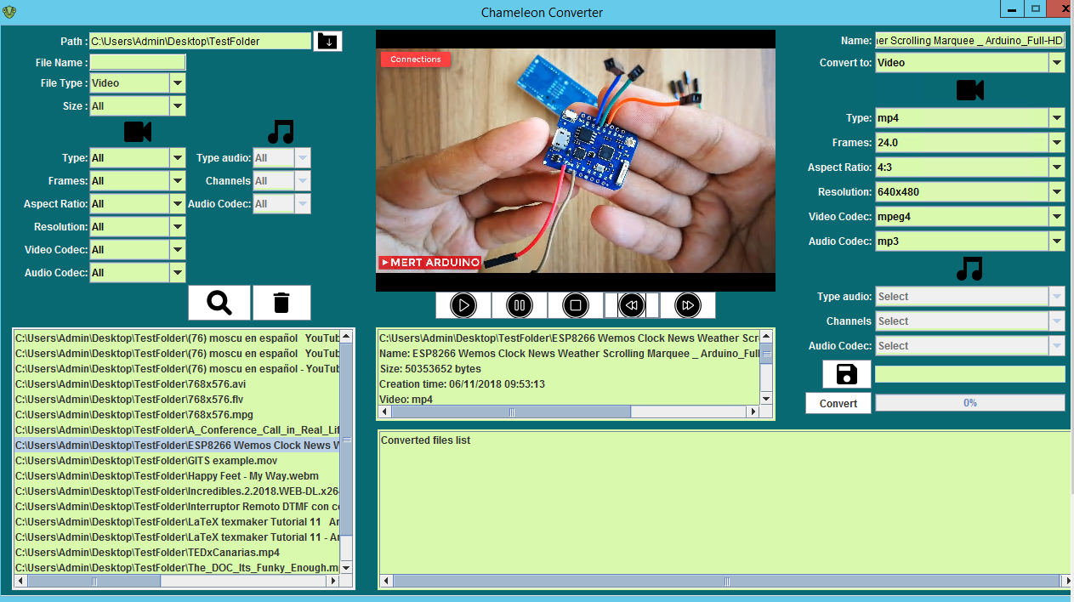
More about Chameleon Converter

Slide 6

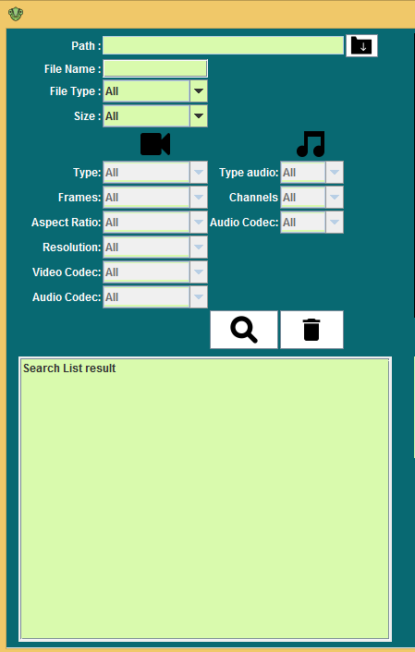



Search

Slide 7

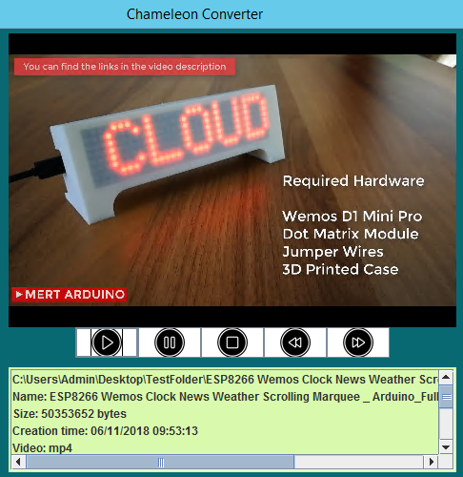
Player

Slide 8
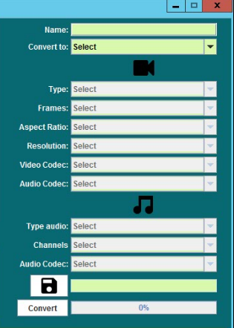
Convertor

Slide 9
View

Slide 10
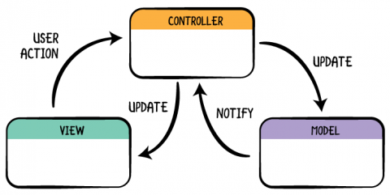
MVC
Notes:
For this project we use an architectural pattern called MVC. We split the business logic of the user interface, making the project more scalable. Each one of us was working on each of these layers, since mvc gives flexibility to the developer and increases the reuse and flexibility of the code.

Slide 11

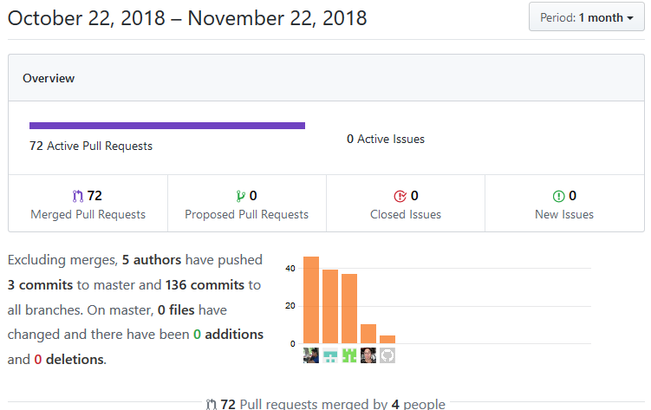
GIT
Notes:
For the control and management of this project, the Git version control system was used.
For the hosting of the repository, the GitHub hosting service was used because it is the perfect option to work as a team in the same project.

Slide 12
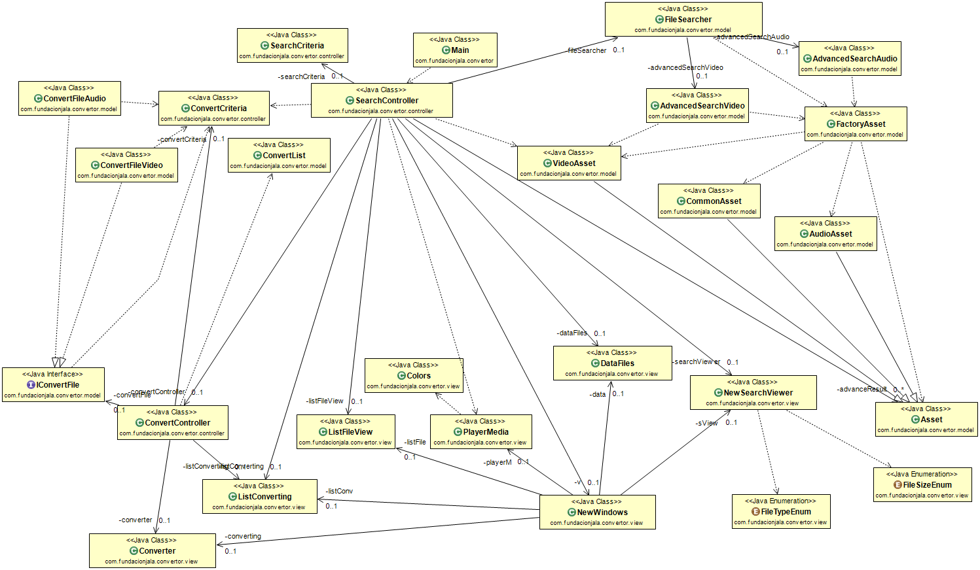
UML Diagram

Slide 13
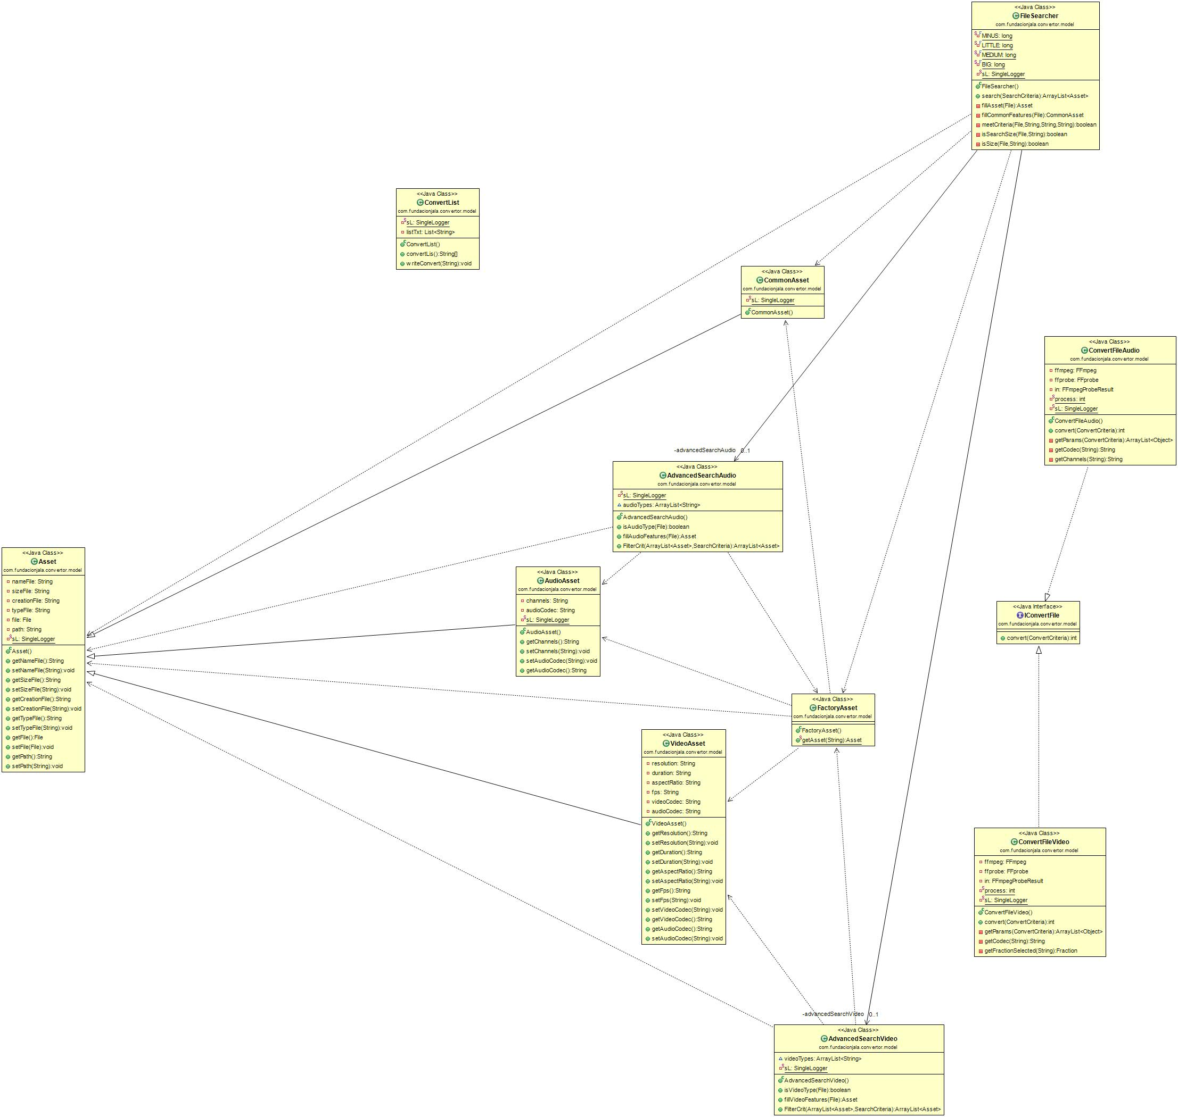
UML Model

Slide 14
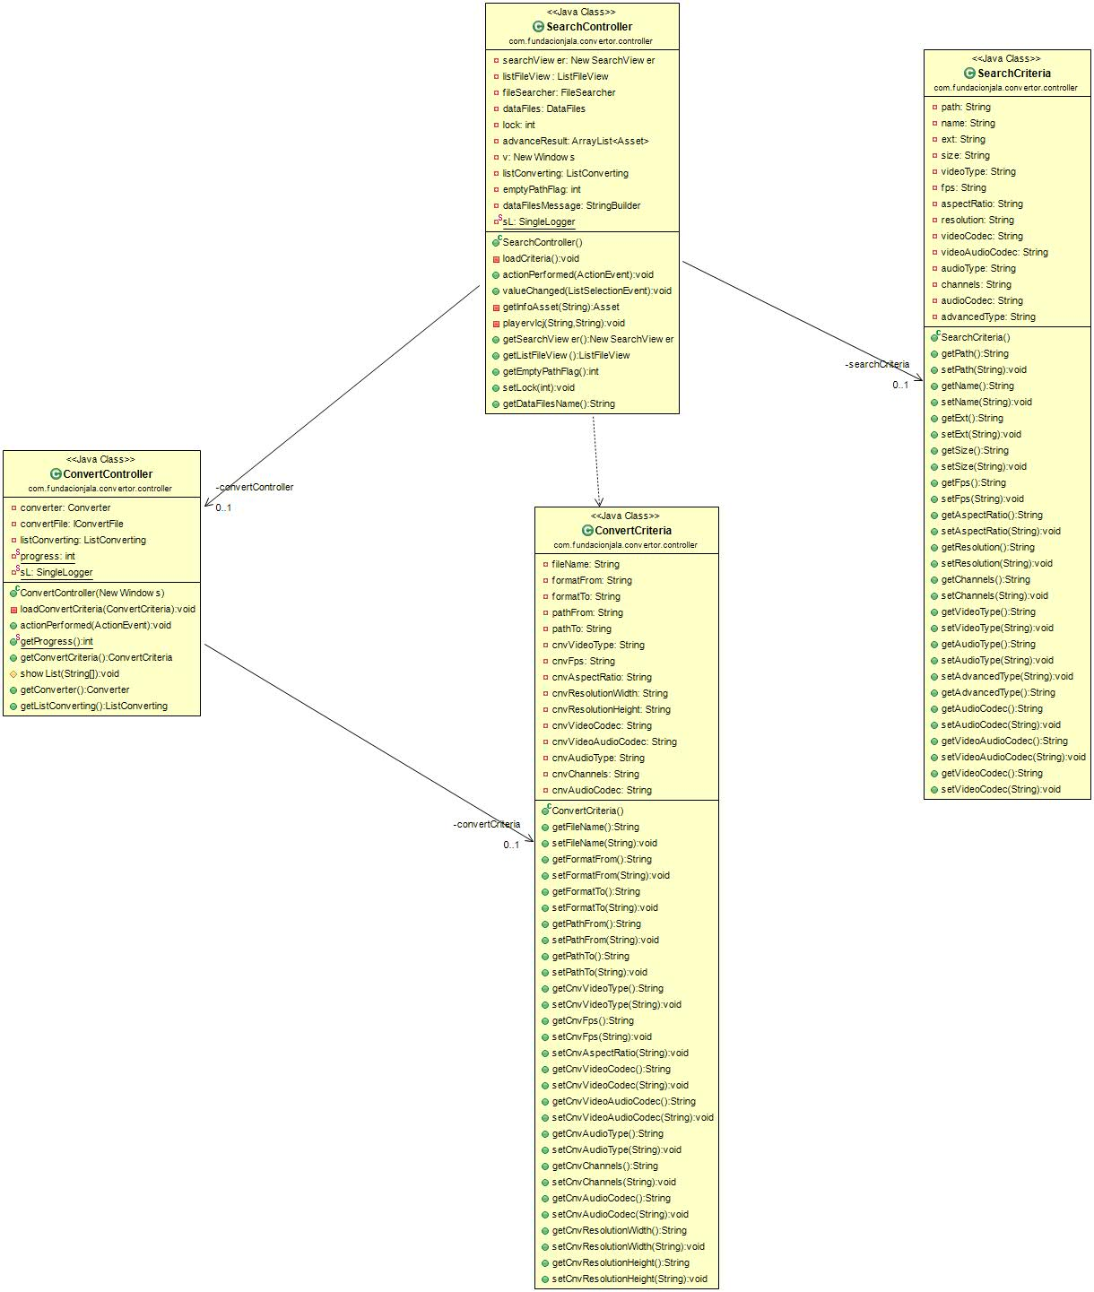
UML Controller

Slide 15
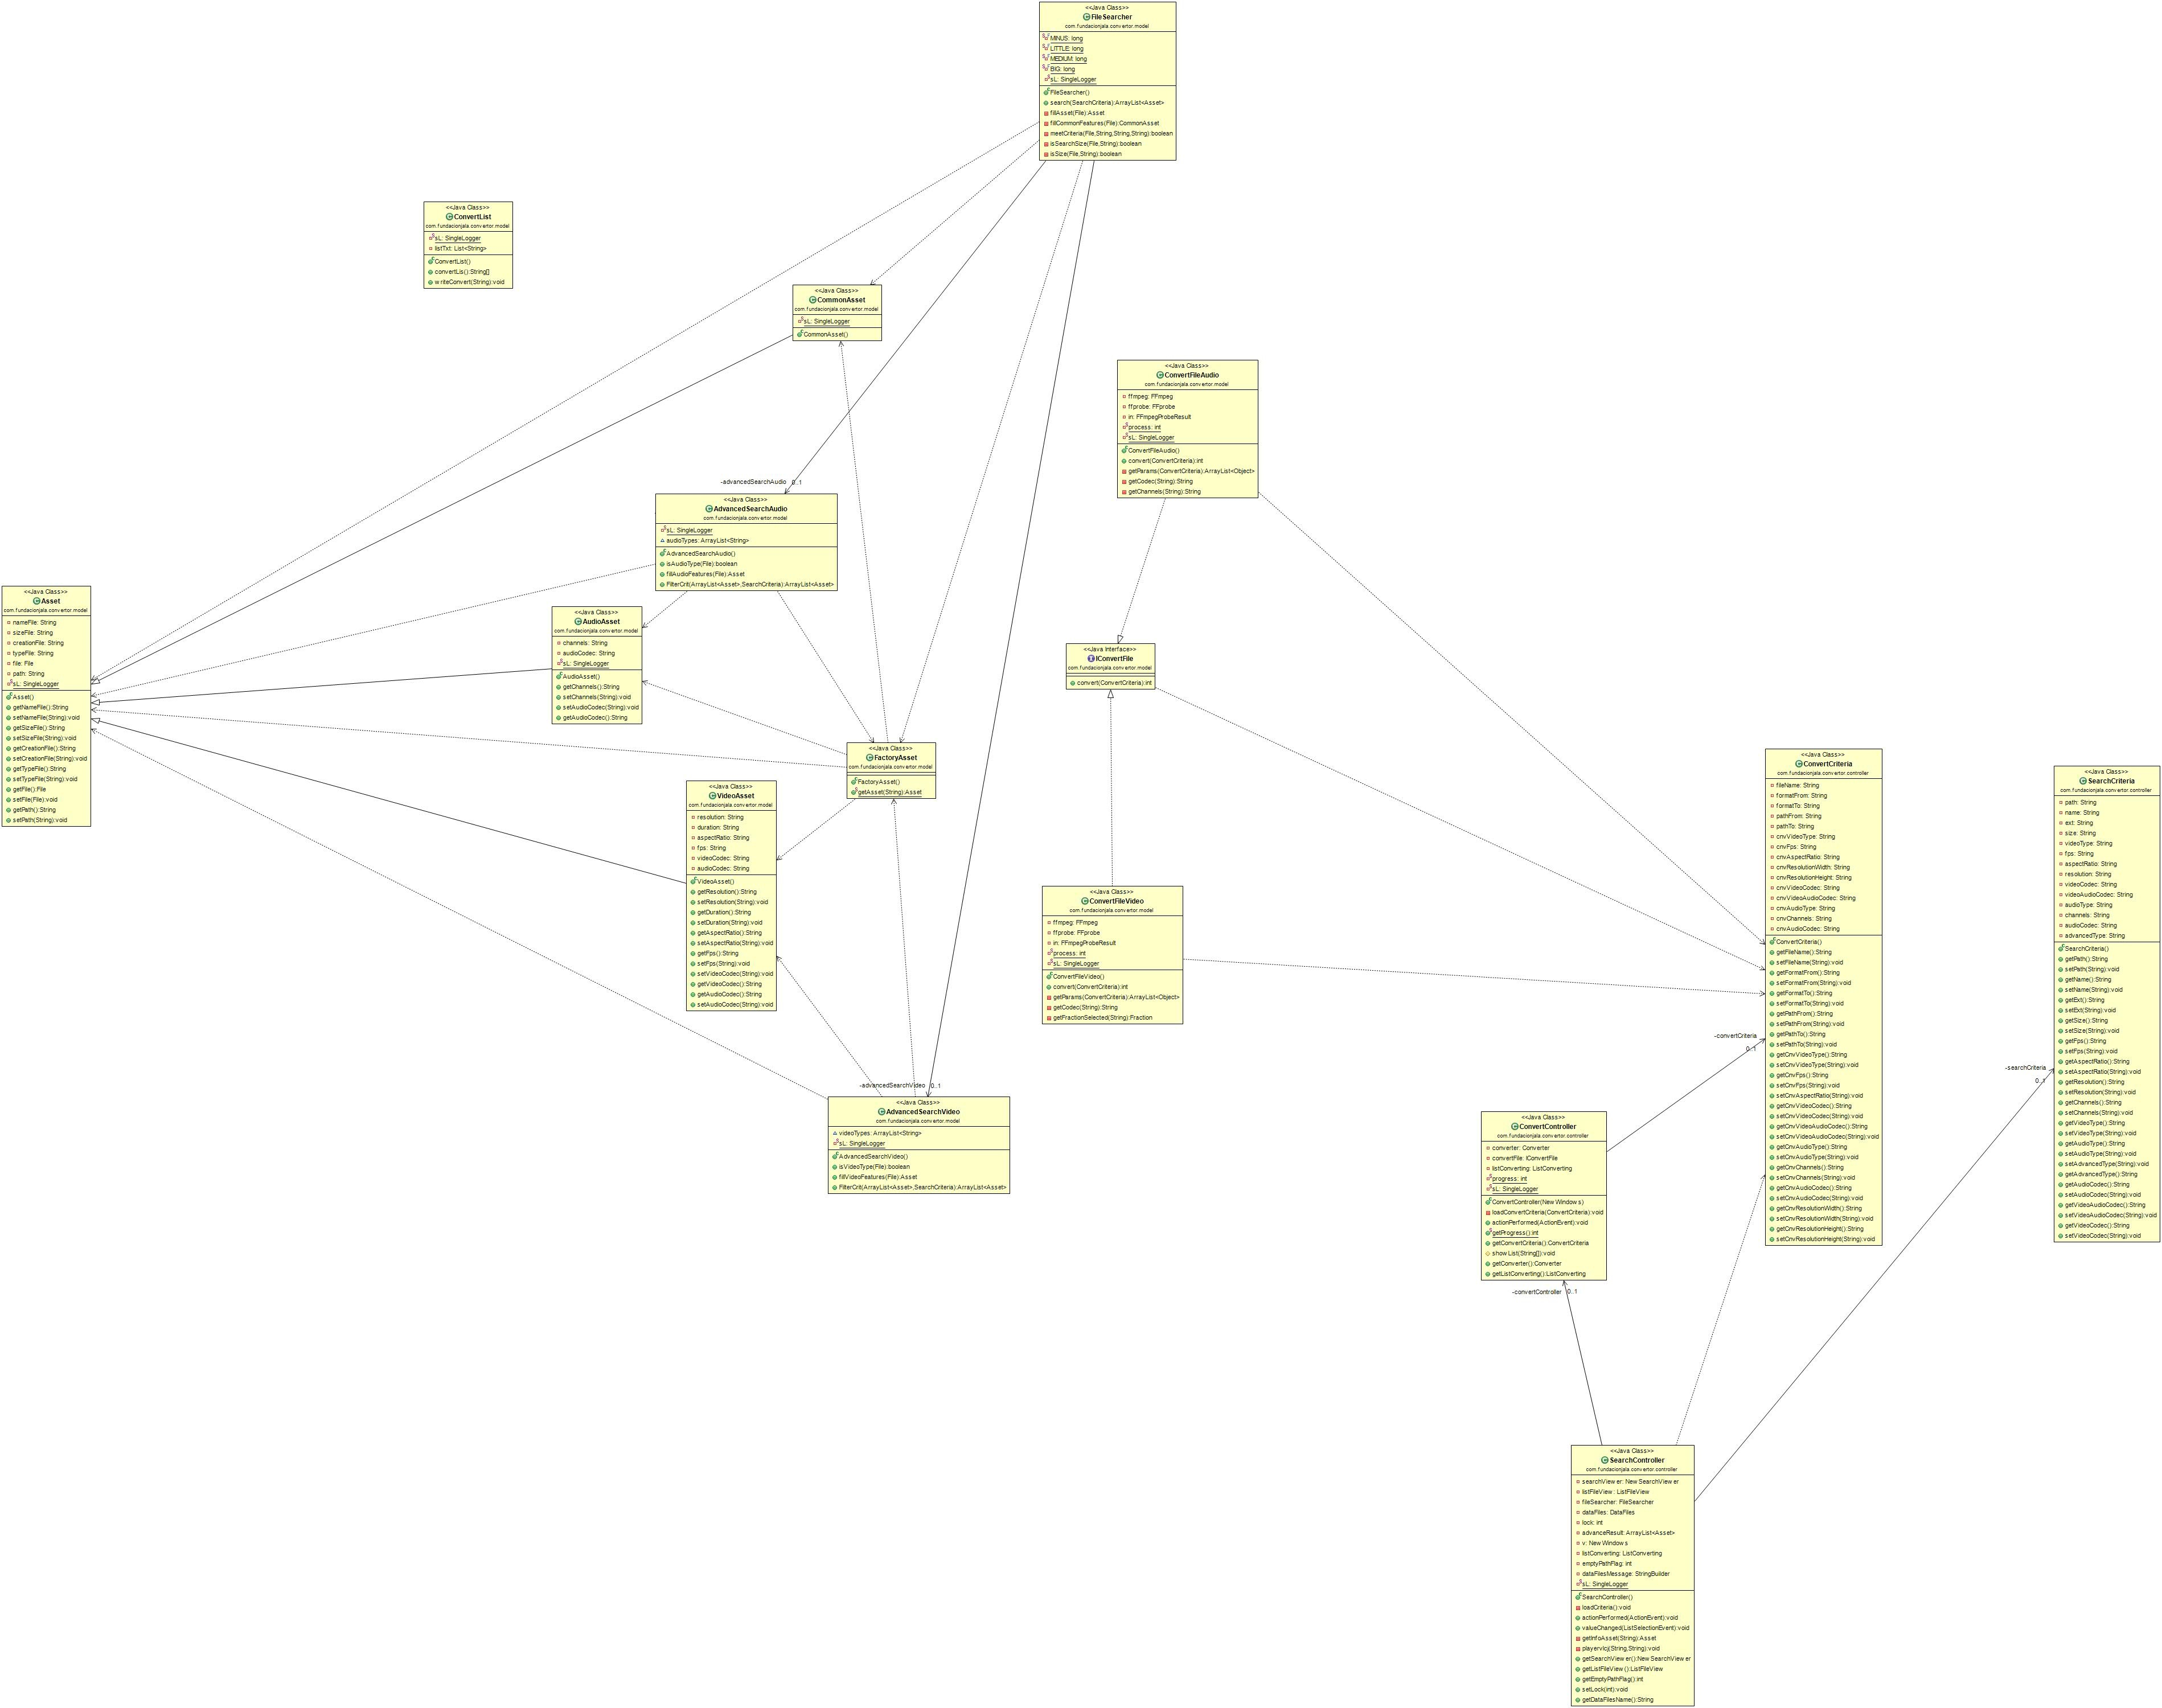
UML Model - Controller

Slide 16
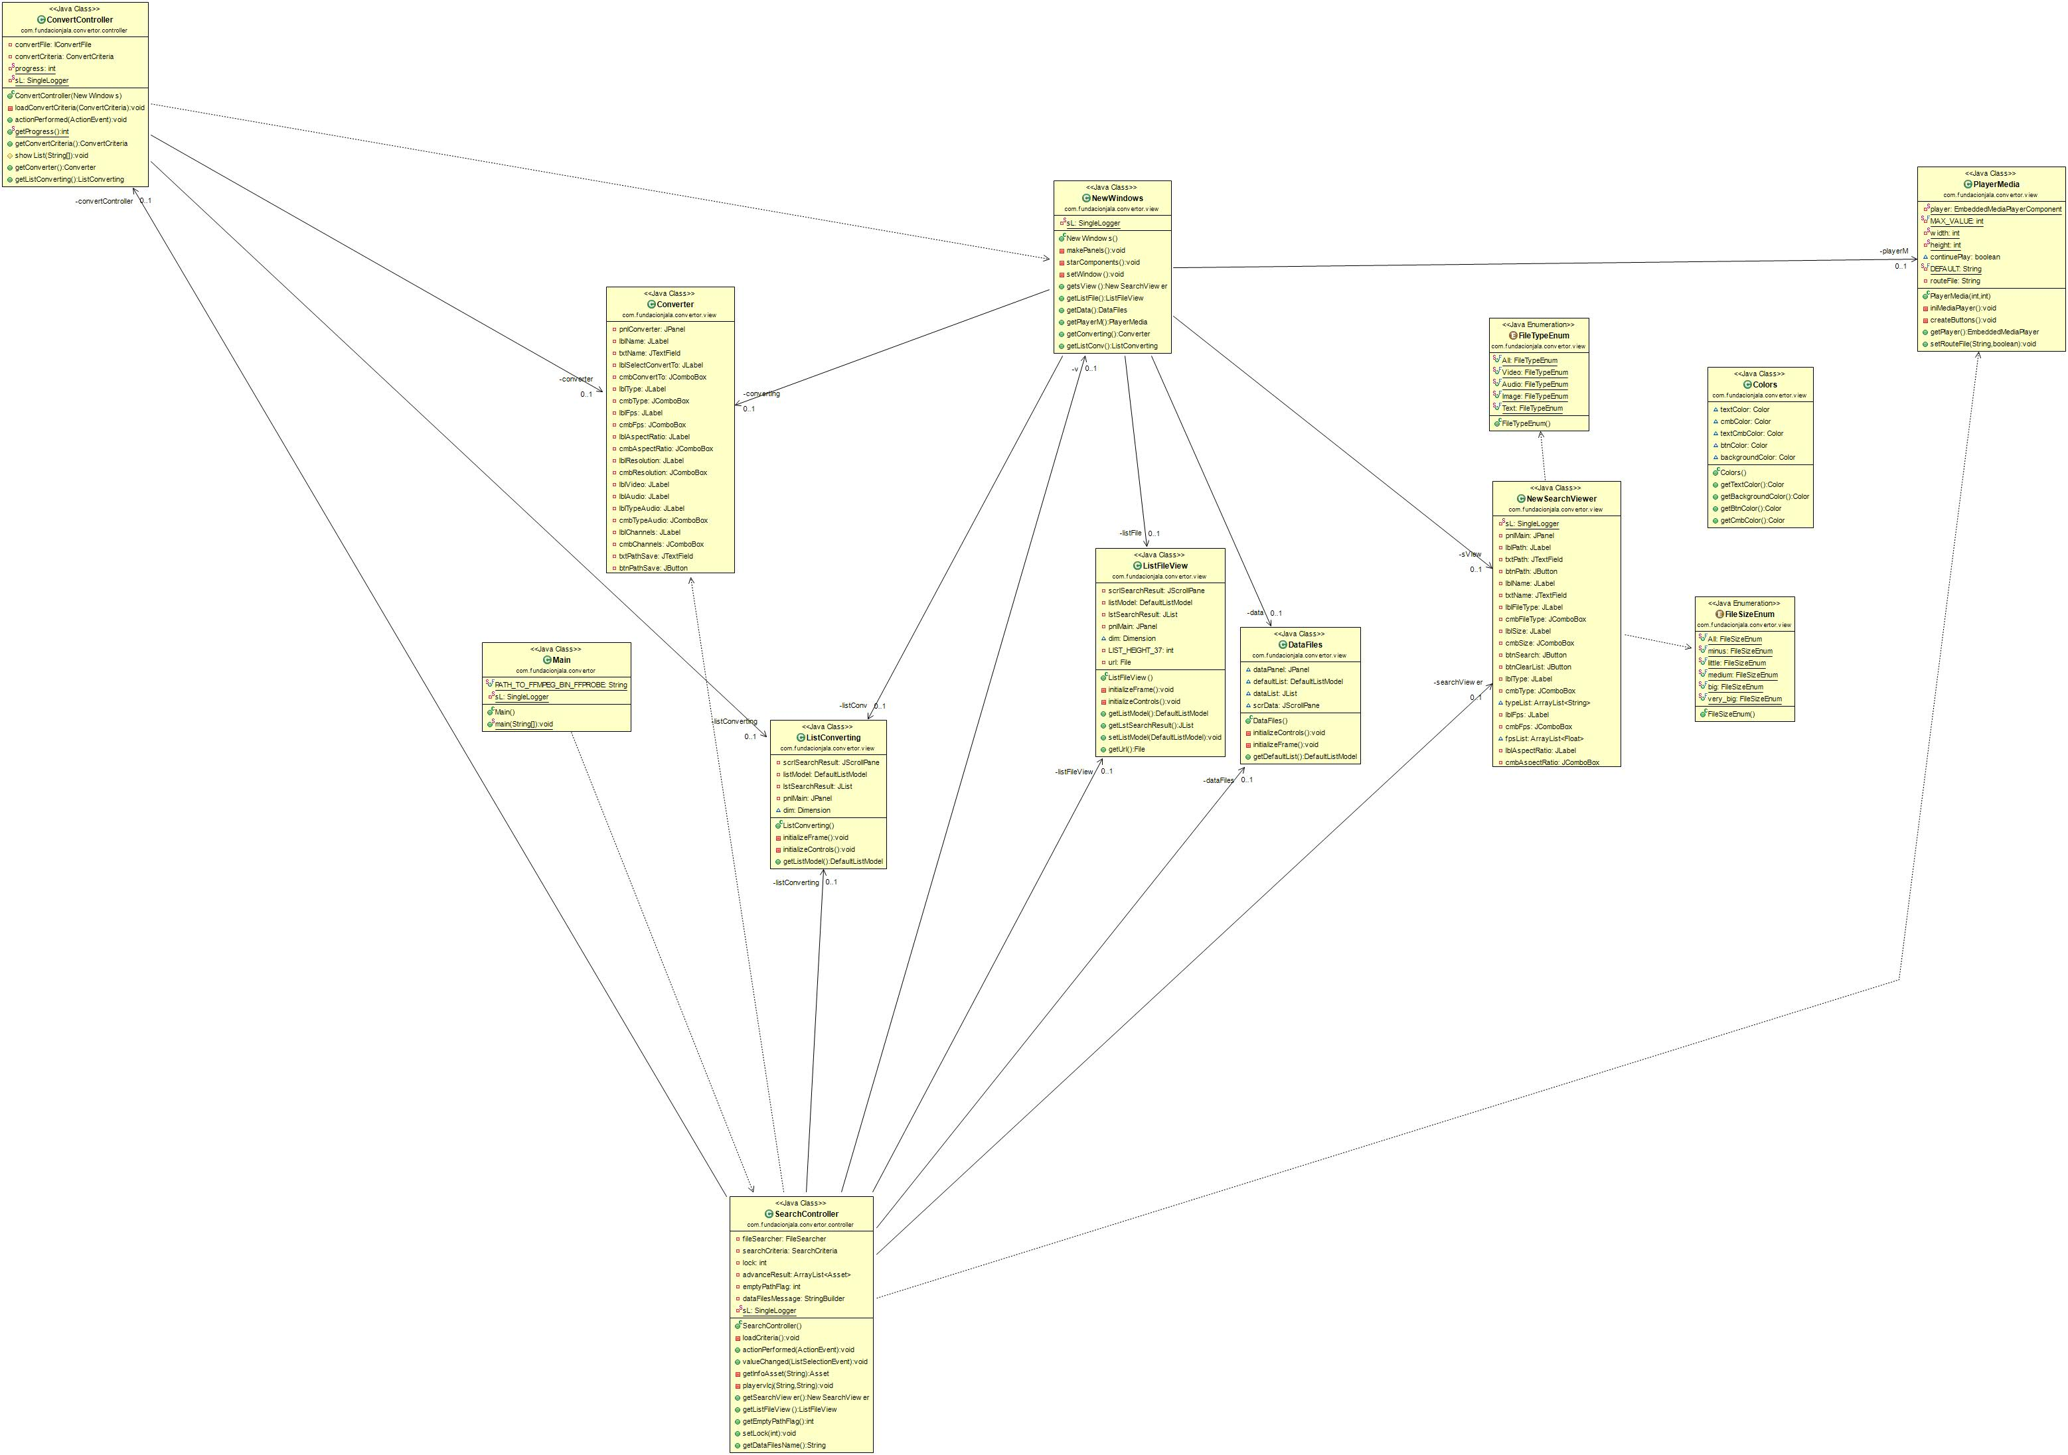
UML Controller - View

Slide 17
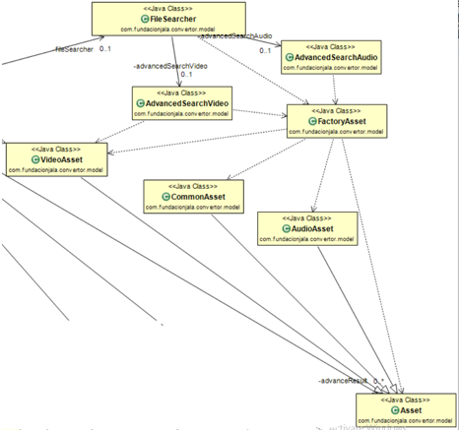
Design patterns used. Factory

Slide 18

Design patterns used. Singleton.
LOGGING
private static SingleLogger sL = SingleLogger.getInstanceLogger();

Slide 19
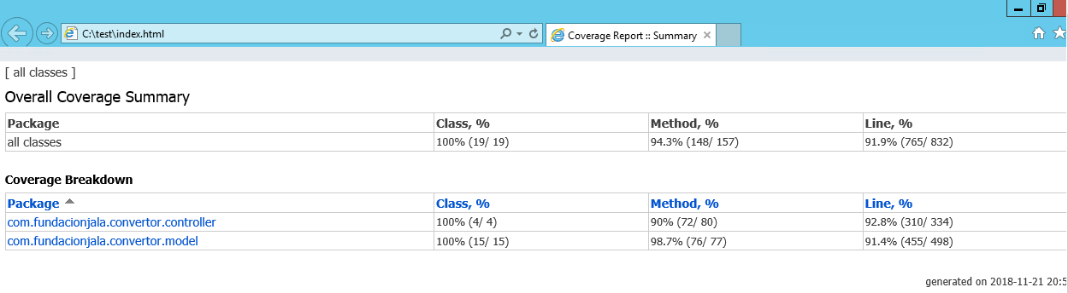
Code Coverage Screenshots

Slide 20
Bugs List
When a video with Audio Codec "ac3", video is played without sound.
Progress bar doesn't work continuously (only from 0 to 100 percent).
Video player cannot be maximized.
When a file in list result search is selected by keyboard, sometimes the file is not loaded in player window.
Some combinations between Type video to convert and Video codec are not working.
The conversion to audio to video no controlling all combinations possible.
Is not possible to convert from Audio to Video. This option is available.
It's not possible to save files converted in C:\\

Slide 21
CREDITS
VIEW by Wilson Lopez.
CONVERTER by Jorge Flores.
SEARCH by Dennis Montaño and Melvi Caballero.

